Slide 1

Module 4
Advanced Multiple Linear Regression (MLR)
Notes:
Guidelines
Use section headers to chunk content in your presentation.
Use the same style of section header throughout your presentation.
Keep your title to no more than 2 lines.

Slide 2
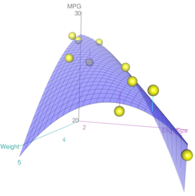
Polynomial Models
Notes:
Guidelines
Use a title slide at the beginning of your presentation. There are 9 variations of title slides to choose from.
If you will have a series of slideshows, we recommend using the same style of title slide for each presentation.
Keep your title to no more than 2 lines.
Do not change the font style or font size of the title or subtitle.

Slide 3



Please download and install the Slido app on all computers you use
How many model df does the variable highwaympg contribute?
ⓘ Start presenting to display the poll results on this slide.

Slide 4
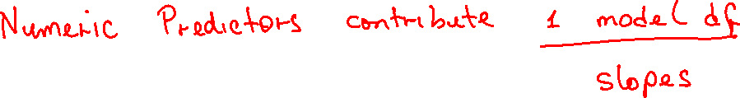

Slide 5
Please download and install the Slido app on all computers you use
How many model df does the variable fuelsystem contribute?
ⓘ Start presenting to display the poll results on this slide.

Slide 6
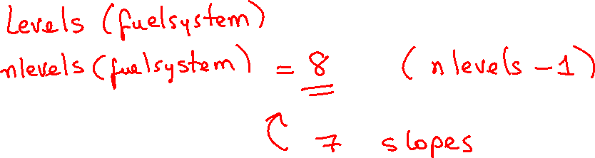

Slide 7
Please download and install the Slido app on all computers you use
What is the base (reference) level for the fueltype variable?
ⓘ Start presenting to display the poll results on this slide.

Slide 8
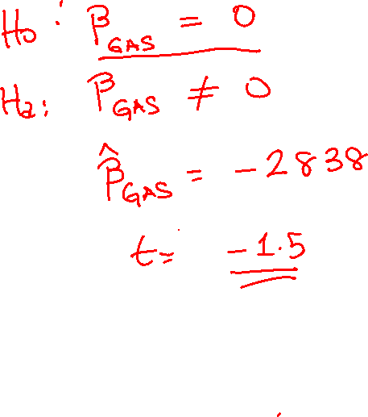

Slide 9
Please download and install the Slido app on all computers you use
What is the base level for the variable carbody?
ⓘ Start presenting to display the poll results on this slide.

Slide 10
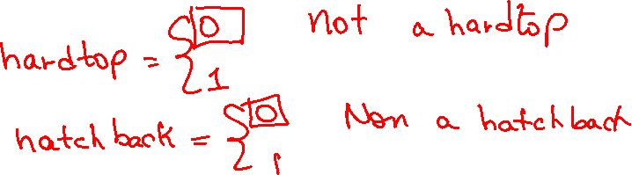

Slide 11


Please download and install the Slido app on all computers you use
Interpret the y-intercept in the language of the problem
ⓘ Start presenting to display the poll results on this slide.

Slide 13
Please download and install the Slido app on all computers you use
Which carbody type is the least expensive?
ⓘ Start presenting to display the poll results on this slide.

Slide 15
Please download and install the Slido app on all computers you use
Predict the price of a sedan with 102cc of horsepower, which gets 25mpg.
ⓘ Start presenting to display the poll results on this slide.

Slide 16
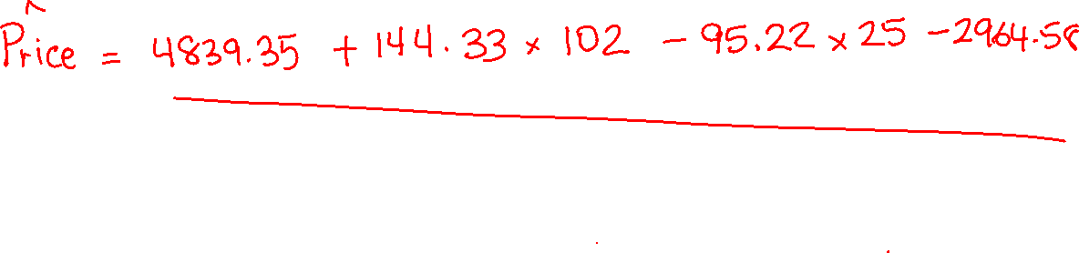

Slide 17
Please download and install the Slido app on all computers you use
Should you drop city mpg from the model?
ⓘ Start presenting to display the poll results on this slide.

Slide 18
Please download and install the Slido app on all computers you use
Should you drop carbodyhardtop from the model?
ⓘ Start presenting to display the poll results on this slide.

Slide 19
Please download and install the Slido app on all computers you use
Write the effect “equation” for the variable city mpg?
ⓘ Start presenting to display the poll results on this slide.

